Slide 1
Project TER
An Empirical Study on Hyperparameters for Twitter Sentiment Analysis Using Machine Learning and Deep Learning Techniques
DIALLO Mamadou Yaya Chérif
KANCHERLA Manideep Reddy
Master 1 – Computer Vision & Intelligent Machines

Slide 2
Index
Introduction
Literature Review
Methodology
Results and Discussion
Conclusion

Slide 3
Introduction
Social Networking Services became an integral part of today’s society
Understanding and predicting sentiments will become a key industry
Project implements 3 machine learning techniques and a BiLSTM neural network to predict sentiments
Followed by hyperparameter tuning in order to improve the accuracy
Our core objective is to study the effect of hyperparameters on the final accuracy and extract meaningful conclusions

Slide 4
1.Literature Review
Sentiment Analysis
Neural Networks – Hyperparameter Tuning
Machine Learning Algorithms - Hyperparameters

Slide 5
2.1. Materials
2.Methodology
Laptop Specifications:
  AMD Ryzen 7 4800H with Radeon Graphics 2.90 GHz
  16,0 GB RAM (15,4 GB usable)
Google Colab
Language: Python
Dataset: People’s sentiment of US airlines divided into 3 classes (14700 tweets)

Slide 6
2.2. Machine Learning Approach
2.Materials and Methodology
Installing and Importing Dependencies
  Pandas, matplotlib, nltk (Natural Language Processing Toolkit), sklearn etc.
Data Acquisition and Data Storage
  Stored in a database using sqlite
  Uploaded to Colab by mounting the drive

Slide 7
2.2. Machine Learning Approach
2.Materials and Methodology
Text Preprocessing and Cleaning
  Stopwords, Cleaning Punctuations, Cleaning URLs, Stemming, Lemmatizing
  Words to Vectors using CountVectorizer
Text Analysis – Machine Learning Approach
  Support Vector Machines - Linear and RBF kernels
  Logistic Regression,
  Random Forest Classifier

Slide 8
2.2. Machine Learning Approach
2.Materials and Methodology
Hyperparameter Tuning
  Hyperparameter C for Logistic Regression
  Hyperparameter C for SVM
  Hyperparameter n_estimators for Random Forest Classifier

Slide 9
2.3. Deep Learning Approach
2.Materials and Methodology
Installing and Importing Dependencies
  Pytorch
Text Preprocessing and Data Cleaning
  Removal of null values, links, mentions etc.
  Encoding all tweets

Slide 10
2.3. Deep Learning Approach
2.Materials and Methodology
BiLSTM Model Building
  Initialization
    Embedding Layer -> LSTM -> Dropout -> FC (Fully-connected Layer)
  Forward Function
    Input transformed to Embeddings -> LSTM -> Dropout -> FC (Fully-connected Layer) -> SOFTMAX

Slide 11
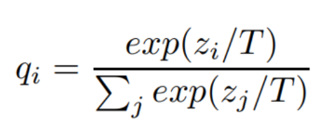
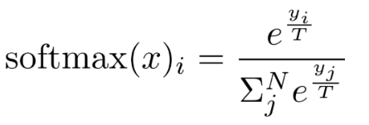
2.3. Deep Learning Approach
2.Materials and Methodology
Hyperparameter Tuning - Temperature

Slide 12
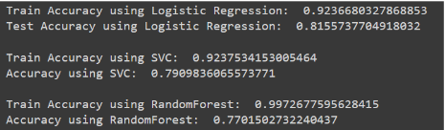
3.1. Machine Learning Approach
2.Results and Discussion
Initial accuracies before hyperparameter tuning:

Slide 13
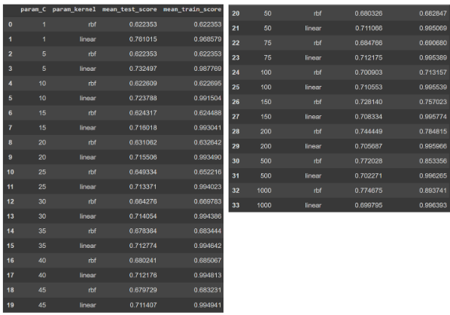
3.1. Machine Learning Approach
2.Results and Discussion
Support Vector Machines after Hyperparameter optimization:
More adapted to a Linear Kernel
~99.6% maximum training accuracy (linear kernel) of detecting text sentiments of US airline customers
~77% maximum testing accuracy (RBF Kernel) of detecting text sentiments of US airline customers

Slide 14
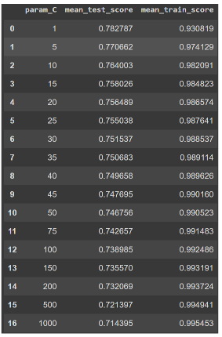
3.1. Machine Learning Approach
2.Results and Discussion
Logistic Regression after Hyperparameter optimization:
Persisting problems of overfitting
~99.5% maximum training accuracy of detecting text sentiments of US Airline customers
~78% maximum testing accuracy of detecting text sentiments of US airline customers

Slide 15
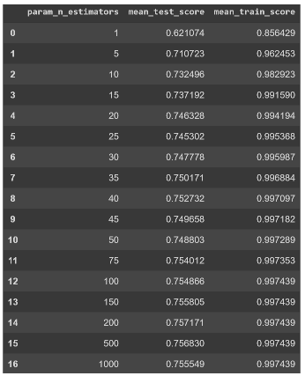
3.1. Machine Learning Approach
2.Results and Discussion
Random Forest Classifier after Hyperparameter optimization:
Persisting problems of overfitting
~99.7% maximum training accuracy of detecting text sentiments of US Airline customers
~75.7% maximum testing accuracy of detecting text sentiments of US airline customers

Slide 16
3.2. Deep Learning Approach
2.Materials and Methodology
No apparent correlation observable
~63.225% maximum accuracy of detecting text sentiments of US Airline customers

Slide 17
Conclusion
Initial plan – Work on large image datasets but we had hardware problems and processing the data
Extensive literature review, two comprehensive methodologies for sentiment classification along with hyperparameter tuning to improve optimizations
Positive results with an increase of training accuracy but tends to overfit the data for the testing accuracy
In the future, implement the initial plan of hyperparameter temperature tuning with multiple feature extractors on large image datasets in the future

Slide 18
Thank You For Your Attention !!!

